Slide 1


Raphael Nnaemelum Ogbodo
November 18, 2025
University of Iowa.

Slide 2

Outline
Executive Summary
Introduction
Methodology
Results
Conclusion
Appendix

Slide 3
Executive Summary
Summary of methodologies
Collected and cleaned SpaceX launch data from REST API and web sources
Performed exploratory data analysis to identify trends in payload, launch site, orbit, and booster version.
Built ML models (Logistic Regression, KNN, SVM, Decision Tree) and tuned them with GridSearchCV
Summary of all results
Landing success strongly depends on booster version, payload mass, and launch site
Decision Tree (tuned) showed the highest prediction accuracy
KSC LC-39A exhibited the highest landing success rates
ML models can reliably predict Falcon 9 landing outcomes, supporting cost-efficient mission planning

Slide 4
Introduction
Project Background and Context
SpaceX aims to reduce launch costs by successfully landing and reusing the Falcon 9 first stage.
Understanding which factors influence landing success helps optimize operations and support mission planning.
The dataset includes launch records, booster details, payload mass, orbit types, and landing outcomes.
Problems Statements
What factors most strongly determine whether a Falcon 9 booster will land successfully?
Can machine learning models accurately predict landing success?
How do payload mass, launch site, orbit type, and booster version influence landing outcomes?

Slide 5

Section 1

Slide 6
Methodology
Executive Summary
Data collection methodology:
Describe how data was collected
Perform data wrangling
Describe how data was processed
Perform exploratory data analysis (EDA) using visualization and SQL
Perform interactive visual analytics using Folium and Plotly Dash
Perform predictive analysis using classification models
How to build, tune, evaluate classification models

Slide 7
Data Collection
How the Data Was Collected
Retrieved SpaceX launch records using the SpaceX REST API
Scraped historical data from Wikipedia launch tables
Loaded datasets into Pandas DataFrames
Cleaned and merged datasets (handled missing values, standardized columns)
Prepared final dataset for EDA and Machine Learning
SpaceX API
Wikipedia Tables
Data Extraction
Save Raw Dataset

Slide 8
Data Collection – SpaceX API
SpaceX REST API calls was made using a statistic response object (static_json_url).
Response content (Json) of the Get request method used above was turned into a dataframe using .json_normalize() method in pandas.
GitHub URL: https://github.com/Raphaelogbodo/Data-Science-Course/blob/main/jupyter-labs-spacex-data-collection-api.ipynb
static_json_url
requests.get(statict_json_url)
response
pd.json_normalize(response.json())
data

Slide 9
Data Collection - Scraping
Key steps and Phrases
Identified target table on Wikipedia: Falcon 9 and Falcon Heavy Launches
Used Requests to fetch HTML content and Parsed HTML using BeautifulSoup
Located and extracted launch data tables
Converted table rows into a structured pandas DataFrame
Cleaned text fields (dates, booster versions, payload mass, landing outcomes
Stored processed data for EDA and Machine Learning
GitHub URL: https://github.com/Raphaelogbodo/Data-Science-Course/blob/main/jupyter-labs-webscraping.ipynb
Identify Target Webpage
Send HTTP GET Request
Parse HTML (BeautifulSoup)
Locate Launch Data Table
Extract Rows
Convert to DataFrame
Start
End

Slide 10
Data Wrangling
Key steps:
Loaded raw data from API and web scraping into Pandas
Handled missing values
Cleaned text fields (booster version, landing outcome, orbit)
Converted data types
Engineered new features (class label for landing success, one-hot encoding for categorical variables)
Normalized/Scaled numeric features for ML modeling
Load Raw Data
Handle Missing Values
Clean text fields
Convert data types
Engineer new features
Normalize/Scaled numeric features
GitHub URL: https://github.com/Raphaelogbodo/Data-Science-Course/blob/main/labs-jupyter-spacex-Data%20wrangling.ipynb

Slide 11
EDA with Data Visualization
Charts used EDA
Categorical plots were used to find relationship between/among variables below:
LaunchSite vs FlightNumber (Class as hue)
LaunchSite vs PayloadMass (Class as hue)
Orbit vs FlightNumber (Class as hue)
Orbit vs PayloadMass (Class as hue)
Bar Chart to visualize relationship between success rate of each orbit type
Line plot to visualize launch success yearly trend
GitHub URL: https://github.com/Raphaelogbodo/Data-Science-Course/blob/main/edadataviz.ipynb

Slide 12
EDA with SQL
Bullet summary of the SQL queries performed
Identified all unique launch sites and previewed sample launches from key sites.
Analyzed payloads by customer and booster version, including average payload mass for F9 v1.1 and total NASA (CRS) payloads
Examined landing outcomes: first successful landing, successful drone landings for 4000–6000 kg payloads, and overall counts of successes and failures.
Investigated extreme payloads, highlighting the booster used for the heaviest launch.
Explored temporal trends and failures: monthly drone landing failures in 2015 and overall landing outcome trends between 2010–2017.
GitHub URL: https://github.com/Raphaelogbodo/Data-Science-Course/blob/main/jupyter-labs-eda-sql-coursera_sqllite.ipynb

Slide 13
Build an Interactive Map with Folium
Summary off the interactive map
Created a base Folium map centered on SpaceX launch sites to provide geographic context.
Added markers for each launch site to indicate exact locations and show popups with site name, total launches, and success rate.
Added circle markers to represent payload mass or launch success, using size and color to visualize differences across sites.
Included popups and tooltips for interactive exploration, displaying detailed information like booster version, date, and landing outcome.
Used color coding to distinguish between successful and failed launches for quick visual interpretation.
Added lines or polylines to illustrate launch trajectories or connections between sites, highlighting spatial patterns
GitHub URL: https://github.com/Raphaelogbodo/Data-Science-Course/blob/main/lab_jupyter_launch_site_location.ipynb

Slide 14
Build a Dashboard with Plotly Dash
Dashboard plots/graphs
Scatter plots
Used to show the relationships between payload mass and success rate
Pie chart
Used to show the proportion of successful launches at each site if all sites are considered
Shows proportion of success and failure of launches if individual site is selected
Dropdown is used for site selection
RangeSlider is used for payload mass range selection
GitHub URL: https://github.com/Raphaelogbodo/Data-Science-Course/blob/main/spacex-dash-app.py

Slide 15
Predictive Analysis (Classification)
Models used:
Logistic Regression, DecisionTree Classifier, KNN, and SVM
GridSearchCV to find the best hyperparameters.
Trained with optimal parameters identified by GridSearch.
Evaluated models using accuracy, precision, recall, F1-score, and confusion matrix.
Compared all results and selected the best-performing classifier as the final model
GitHub URL: https://github.com/Raphaelogbodo/Data-Science-Course/blob/main/SpaceX_Machine%20Learning%20Prediction_Part_5.ipynb

Slide 16
Results
Exploratory data analysis results
Interactive analytics demo in screenshots
Predictive analysis results

Slide 17

Section 2

Slide 18
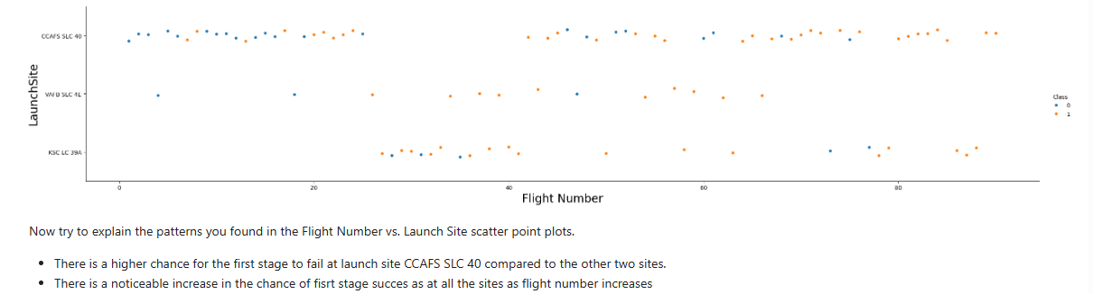
Flight Number vs. Launch Site

Slide 19
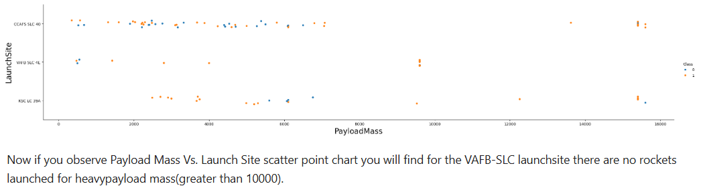
Payload vs. Launch Site

Slide 20
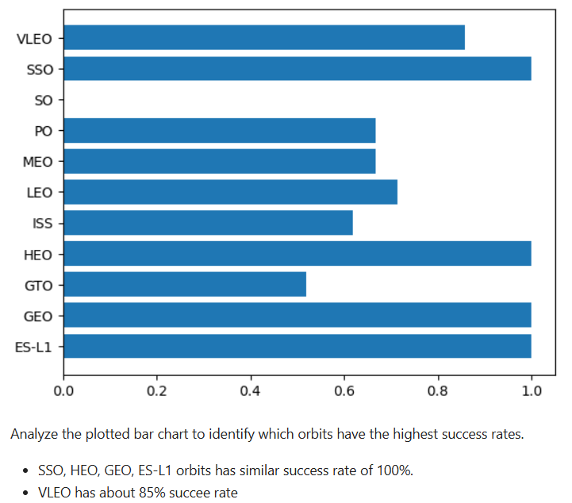
Success Rate vs. Orbit Type

Slide 21
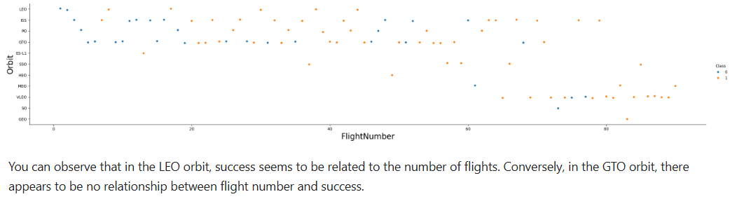
Flight Number vs. Orbit Type

Slide 22
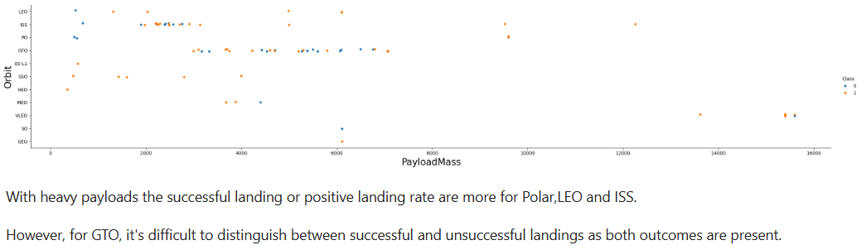
Payload vs. Orbit Type

Slide 23
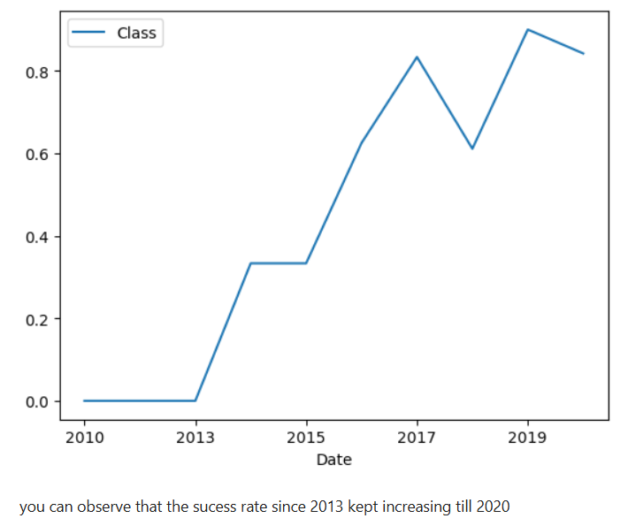
Launch Success Yearly Trend

Slide 24
All Launch Site Names
Querry:
%sql select distinct(Launch_Site) from SPACEXTABLE;
Result:
The above result shows from the table SPACEXTABLE the unique sites as listed in the “Launch Site” column
CCAFS LC-40
VAFB SLC-4E
KSC LC-39A
CCAFS SLC-40

Slide 25
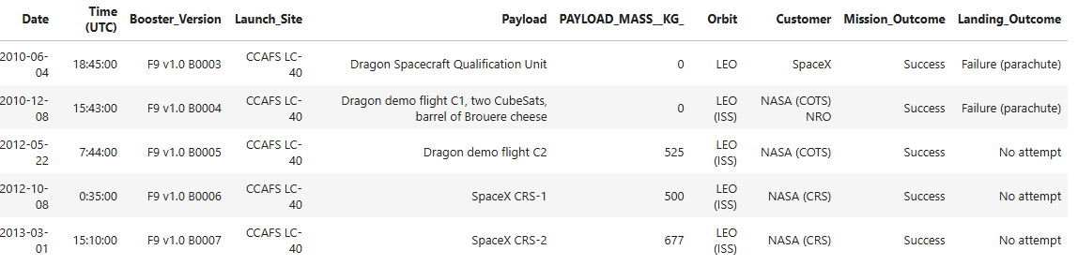
Launch Site Names Begin with 'CCA'
Querry:
%sql select * from SPACEXTABLE where Launch_Site like 'CCA%' limit 5;
Results:
The above result shows the first 5 rows from table “SPACEXTABLE” where column “Launch Site” entries begins with “CCA”

Slide 26
Total Payload Mass
Query:
%sql select sum(PAYLOAD_MASS__KG_) as Tot_payload_mass from SPACEXTABLE where Customer = 'NASA (CRS)’;
Results:
The above result shows the total payload mass in Kg from the “SOACEXTABLE” records where the “Customer” column is “NASA (CRS)”.
Tot_payload_mass
45596

Slide 27
Average Payload Mass by F9 v1.1
Querry:
%sql select AVG(PAYLOAD_MASS__KG_) as avg_payload_mass from SPACEXTABLE where Booster_Version='F9 v1.1';
Results:
The above result shows the average payload mass in Kg of all records in “SPACEXTABLE” where “Booster_Version” column is “v1.1” for only F9 launchers.
avg_payload_mass
2928.4

Slide 28
First Successful Ground Landing Date
Querry:
%sql select min(Date) as first_success from SPACEXTABLE where Landing_Outcome like 'Success%';
Result:
The result shows the date for the first successful landing outcome of the launches.
first_success
2015-12-22

Slide 29
Successful Drone Ship Landing with Payload between 4000 and 6000
Query:
%sql select Booster_Version from SPACEXTABLE where Landing_Outcome like 'Success (drone%' and PAYLOAD_MASS__KG_ > 4000 and PAYLOAD_MASS__KG_ < 6000;
Result:
The result above shows boosters that successfully landed on drone ship for a subset of “SPACEXTABLE” records where “PayloadMass” values are greater than 4000 and less than 6000 Kg.
Booster_Version
F9 FT B1022
F9 FT B1026
F9 FT B1021.2
F9 FT B1031.2

Slide 30
Total Number of Successful and Failure Mission Outcomes
Query:
%sql select count(*) as total_success_failure from SPACEXTABLE where Landing_Outcome like 'Success%' or Landing_Outcome like 'Failure%’;
Result:
The result above shows the combined total of both “Success” and “Failure” landing outcomes as listed in column “Landing_Outcome”.
total_success_failure
71

Slide 31
Boosters Carried Maximum Payload
Query:
%sql select Booster_Version as BV from SPACEXTABLE where PAYLOAD_MASS__KG_=(select max(PAYLOAD_MASS__KG_) from SPACEXTABLE);
Result:
The result above show list of booster versions from “SPACEXTABLE” where payload mass is equal to the maximum mass in “PAYLOAD_MASS__KG_” column. This is an example of a nested query.
BV
F9 B5 B1048.4
F9 B5 B1049.4
F9 B5 B1051.3
F9 B5 B1056.4
F9 B5 B1048.5
F9 B5 B1051.4
F9 B5 B1049.5
F9 B5 B1060.2
F9 B5 B1058.3
F9 B5 B1051.6
F9 B5 B1060.3
F9 B5 B1049.7

Slide 32
2015 Launch Records
Query:
%sql SELECT substr(Date, 6, 2) AS Month, Landing_Outcome, Booster_Version, Launch_Site FROM SPACEXTABLE WHERE substr(Date, 0, 5) = '2015' AND Landing_Outcome LIKE '%Failure (drone%’ ORDER BY Month;
Result:
The result above shows the failed landing outcomes in 2015 and result ordered by month.
Month | Landing_Outcome | Booster_Version | Launch_Site
01 | Failure (drone ship) | F9 v1.1 B1012 | CCAFS LC-40
04 | Failure (drone ship) | F9 v1.1 B1015 | CCAFS LC-40

Slide 33
Rank Landing Outcomes Between 2010-06-04 and 2017-03-20
Query:
%sql SELECT Landing_Outcome, COUNT(*) AS outcome_count FROM SPACEXTABLE WHERE Date BETWEEN '2010-06-04' AND '2017-03-20’ GROUP BY Landing_Outcome ORDER BY outcome_count DESC;
Result:
The result above shows the order of landing outcome counts between the years 2010-06-04 and 2017-03-20 with “No attempt” the highest and “Precluded (done ship)” the least.
Landing_Outcome | outcome_count
No attempt | 10
Success (drone ship) | 5
Failure (drone ship) | 5
Success (ground pad) | 3
Controlled (ocean) | 3
Uncontrolled (ocean) | 2
Failure (parachute) | 2
Precluded (drone ship) | 1

Slide 34

Section 3

Slide 35
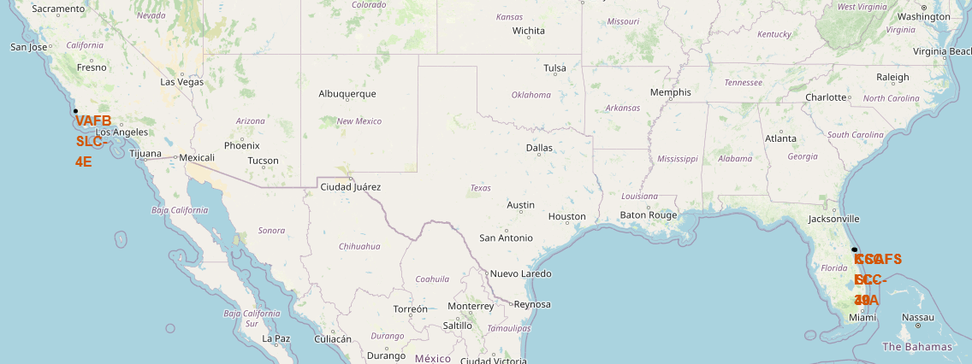
Map of Launch Sites Locations
This map shows the launch site locations depicted with dark circles.

Slide 36
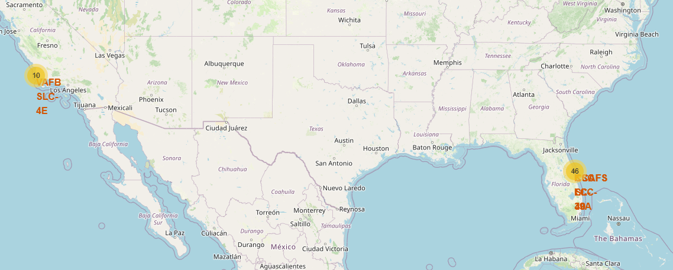
Launch Sites and Outcomes Cluster Map
This map shows both the location of the launch sites and the number of success/failed launches for each side.

Slide 37

Section 4

Slide 38
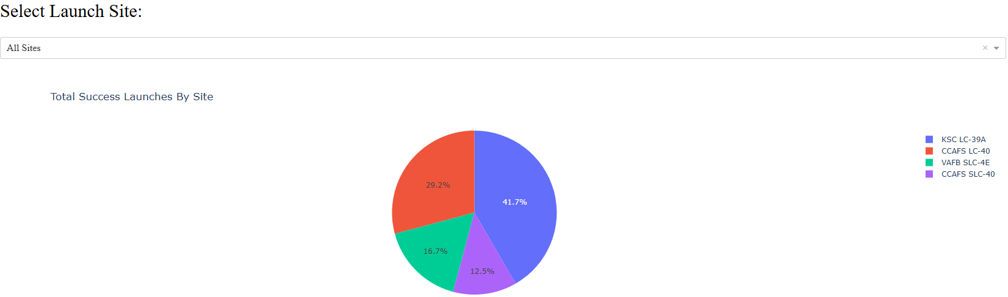
Launch Site Success Proportion
This pie chart shows the proportion of successful launches for each site.

Slide 39
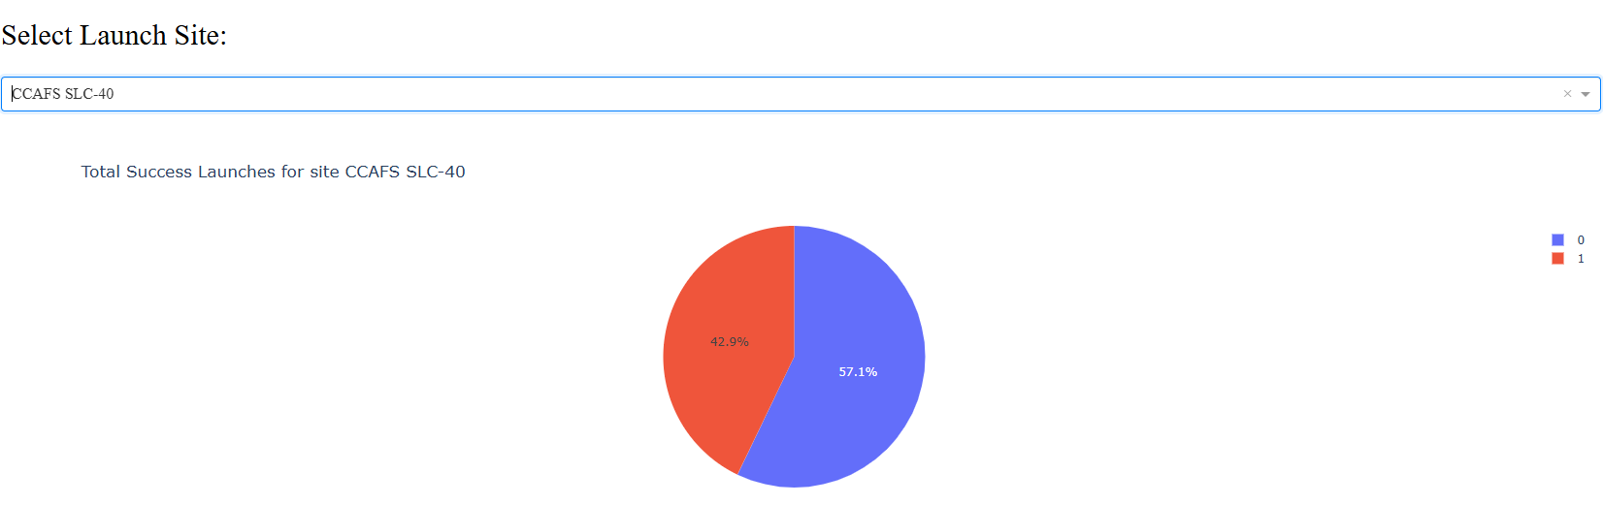
Success/Failure Proportion
Proportion of success (1) and failure (0) for CCAFS SLC-40 with the highest success ratio.

Slide 40
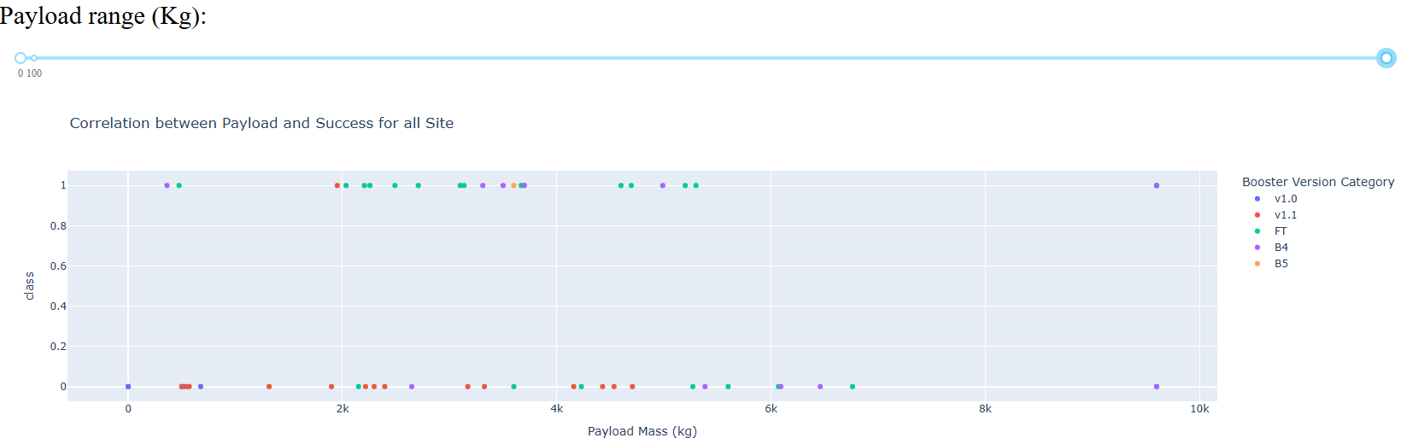
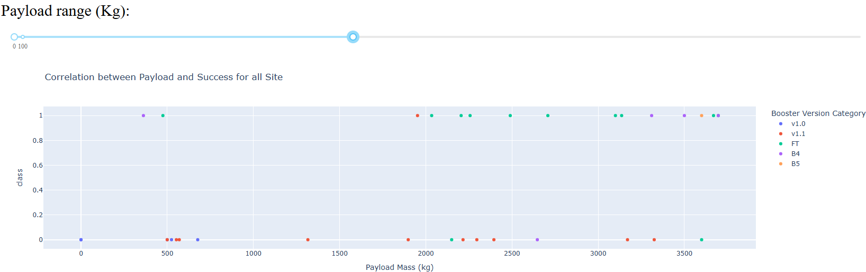
Payload Mass Ranges and Success
The booster version FT (green) records more success for almost all ranges.

Slide 41

Section 5

Slide 42
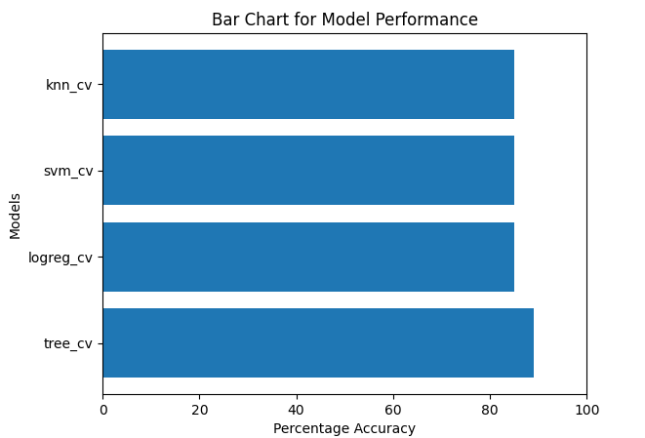
Classification Accuracy
The Decision Tree Classifier model (tree_cv) is the best model with accuracy of 89%

Slide 43
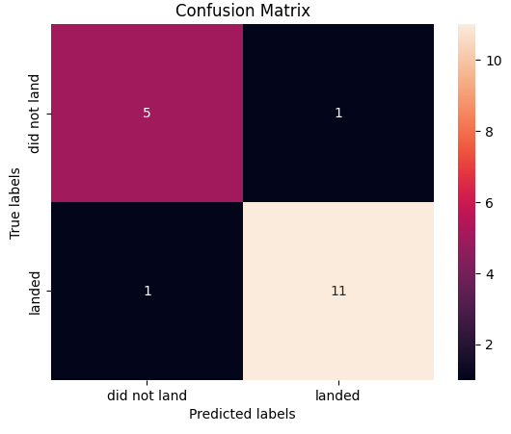
Confusion Matrix
It correctly predicted 11 (TP) and 5 (TN) while incorrectly predicting 1 for FP and FN.
This is much better performance compared to the other models considered.

Slide 44
Conclusions
The exploratory data analysis identified distinct patterns in launch frequency, payload characteristics, and mission outcomes across different sites and booster versions, offering a comprehensive understanding of SpaceX operational trends.
The development of an interactive Folium map provided a clear geographic representation of launch locations and performance variations, enhancing the interpretability of spatial factors influencing mission success.
The classification modelling demonstrated that launch outcomes can be reliably predicted using mission-related features, with performance substantially improved through systematic hyperparameter optimization using GridSearchCV.
The final selected model exhibited strong predictive capability, indicating its potential usefulness for supporting future mission planning and informed decision-making within similar aerospace operational contexts.

Slide 45
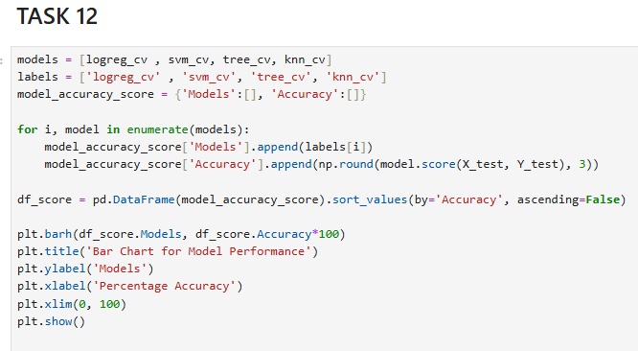
Appendix
The above code snippet was used to calculate and plot the accuracy of the models. I thought it is cool to share.

Slide 46


